Slide 1
Understanding the GitHub Copilot UI

Slide 2
1. Inline Suggestions
2. The Copilot Panel (Chat & Context)
3. Shortcut Keys
4.cli

Slide 3
1. Inline Suggestions
These are Copilot's primary way of helping you code, appearing directly as you type.
What It Is: Gray, ghosted text that automatically appears in your editor as you type. It's Copilot's real-time prediction of what you're trying to code next.
How It Works: Based on your current code, comments, and file names, Copilot generates one or more suggestions.

Slide 4
How to Use It
  Accept a Suggestion: Press the Tab key. This is the most common action.
  See Next Suggestion: If the first suggestion isn't right, press Alt + ] (or Option + ] on Mac).
  See Previous Suggestion: Press Alt + [ (or Option + [ on Mac).
  Dismiss a Suggestion: Simply keep typing, or press Esc. The suggestion will fade away.

Slide 5
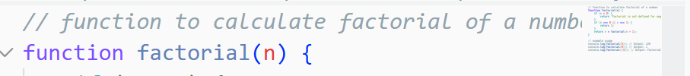
Example:
You type a comment: // function to calculate factorial of a number
As you start typing function factorial, a gray suggestion for the complete function body will appear.

Slide 6
2. The Copilot Panel (Chat & Context)
This is your interactive conversation window with Copilot, providing a more guided and explanatory experience.

Slide 7
What It Is
A separate panel (usually opened on the side of your editor) where you can have a text-based chat with Copilot, ask questions, and give complex commands.

Slide 8
Key Features
  Chat: Ask it to explain code, generate code from a description, find bugs, or get tests.
  Slash Commands: Quick commands that start with / to trigger specific actions.
    /tests - Generate unit tests for your code.
    /explain - Get a plain-English explanation of the selected code.
    /fix - Propose a fix for a potential bug.

Slide 9
Context Awareness
  The chat automatically has access to your open file(s) and the code you've selected, so you can ask questions like "explain this function" without having to paste the code.

Slide 10
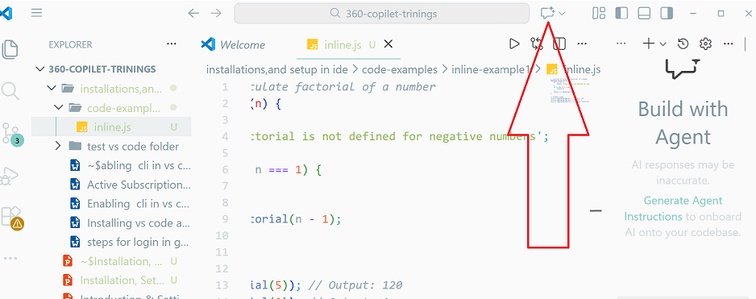
How to Open It
  Click the Copilot icon in the activity bar (side panel) of your editor.
  Use the Keyboard Shortcut: Ctrl + I (Windows/Linux) or Cmd + I (Mac).

Slide 11
3. Shortcut Keys
These are the essential keyboard commands to work efficiently with Copilot.
Trigger Inline Suggestion Manually: If a suggestion doesn't appear, you can explicitly ask for one by pressing Alt + \ (Windows/Linux) or Option + \ (Mac). This is useful when you're stuck.
Open Copilot Chat: Ctrl + I / Cmd + I (as mentioned above).
Cycle Through Inline Suggestions:
  Accept: Tab
  Next Suggestion: Alt + ] (or Option + ])
  Previous Suggestion: Alt + [ (or Option + [)
Accept a Word/Partial Suggestion: Sometimes Copilot suggests a long line, but you only want the next word. Press Alt + → (Right Arrow) or Option + → to accept just one word at a time

